Slide 1

Robotics Lab 3
Day1
Asst. Prof. Dr. Anakkapon Saenthon

Slide 2
Overview Hardware
Webcam
GigE
Camera Link

Slide 3
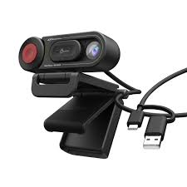
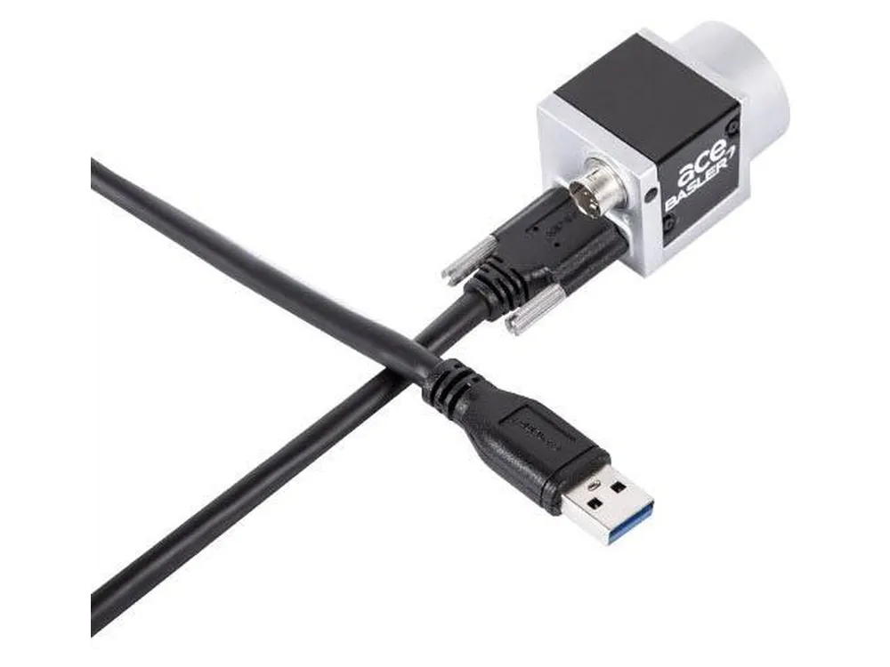
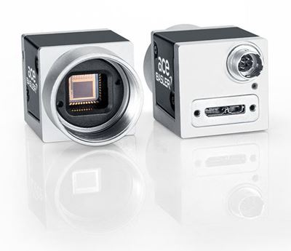
Webcam (protocol USB)
Webcam is a digital camera that can capture video and sometimes audio, and it is typically connected to a computer through a USB (Universal Serial Bus) port. Webcams are commonly used for video conferencing, online streaming, video chats, and other applications where real-time video capture is needed.

Slide 4
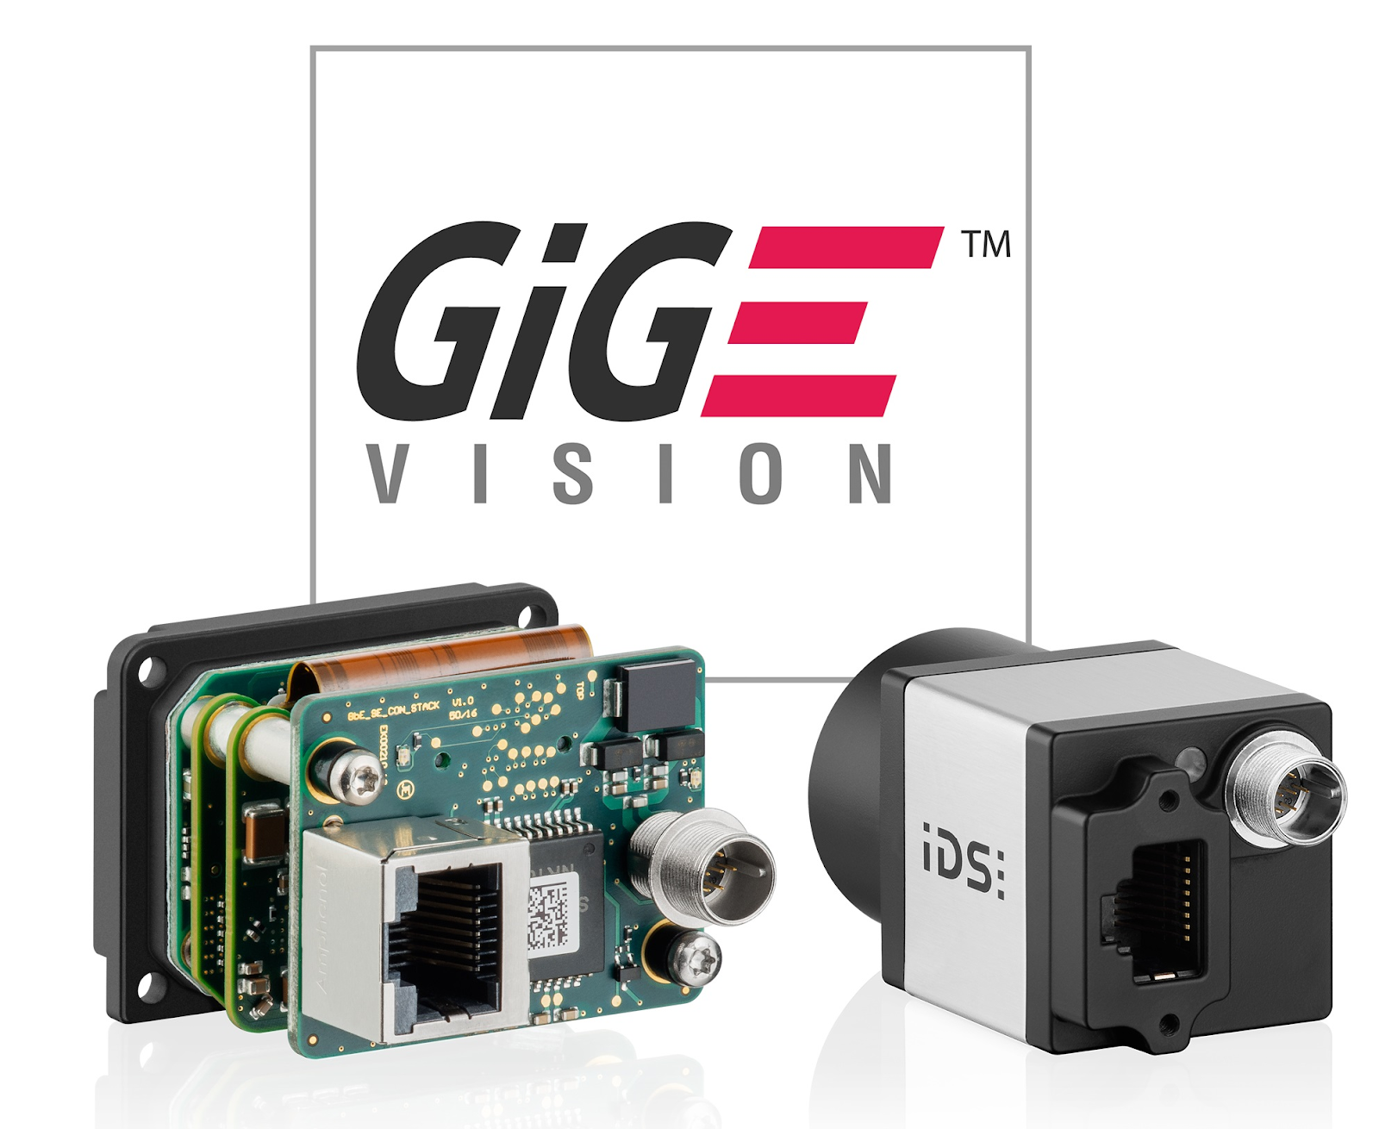
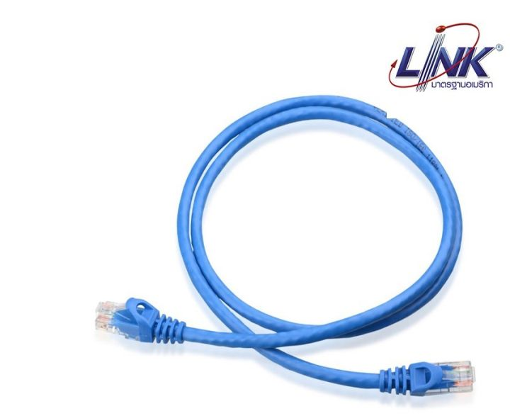
GigE
GigE (short for Gigabit Ethernet) is a network communication standard that enables high-speed data transfer over Ethernet networks. It refers to Ethernet connections capable of reaching speeds of 1 gigabit per second (Gbps) or higher.

Slide 5
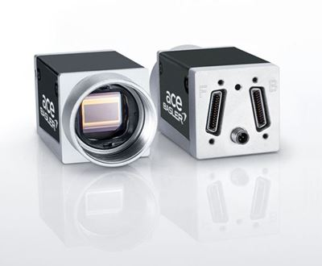
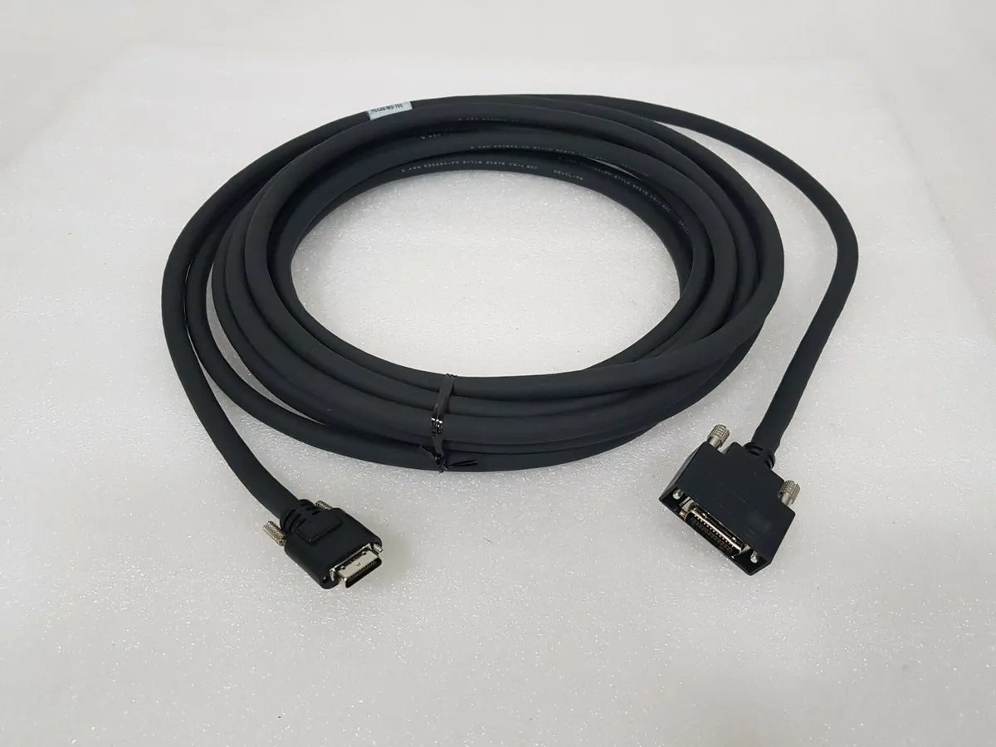
Camera Link
Camera Link is a very robust and powerful interface for industrial cameras of all performance classes. Camera Link is currently the recommended standard interface for data rates from 100 MB/s up to approximately 800 MB/s

Slide 6
Overview Software
Visual Studio (Languages C#)
Emgu Lib

Slide 7
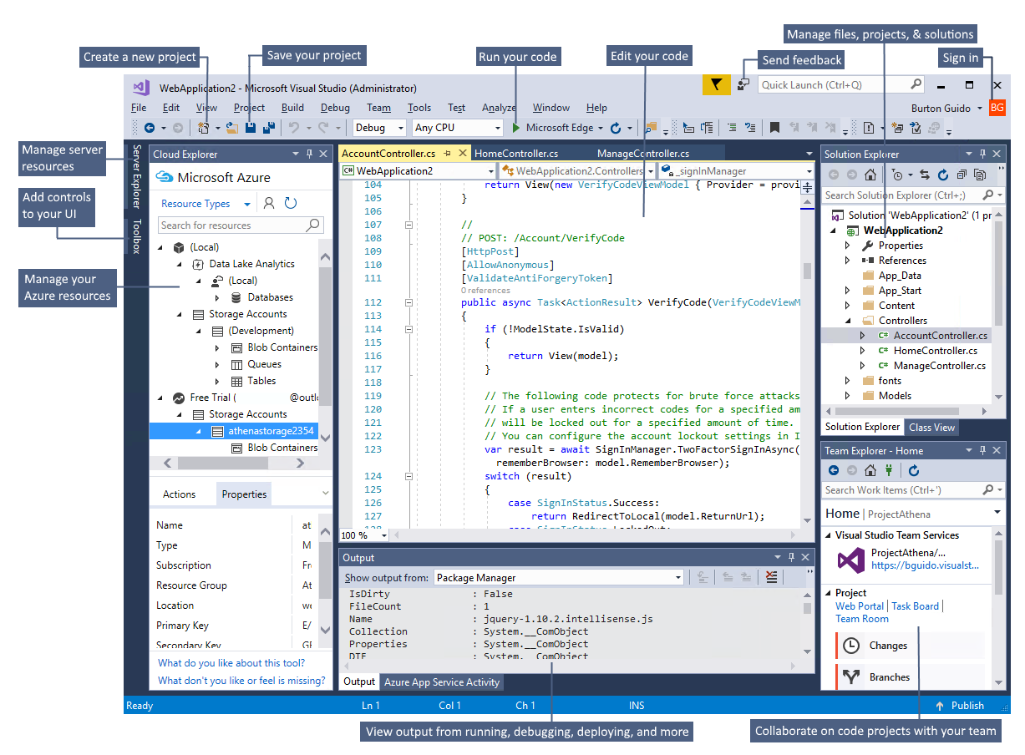

Visual Studio (Languages C#)
Visual Studio is an integrated development environment (IDE) created by Microsoft. It is primarily used for developing applications for the Microsoft Windows platform, including desktop, mobile, web, and cloud-based applications.
Visual Studio supports various programming languages, and for C# developers,
it provides a powerful environment for writing, testing, and debugging C# code.

Slide 8
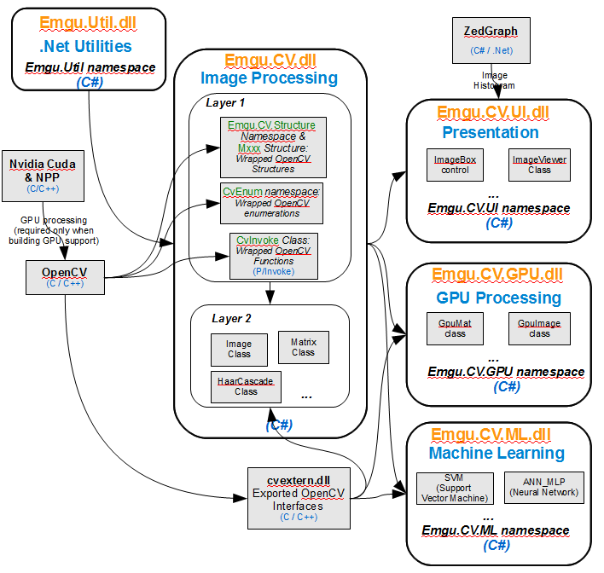

Emgu Library
Emgu CV is a cross platform .NET wrapper to the OpenCV image processing library. Allowing OpenCV functions to be called from .NET compatible languages.
The wrapper can be compiled by Visual Studio and Unity, it can run on Windows, Linux, Mac OS, iOS and Android.

Slide 9
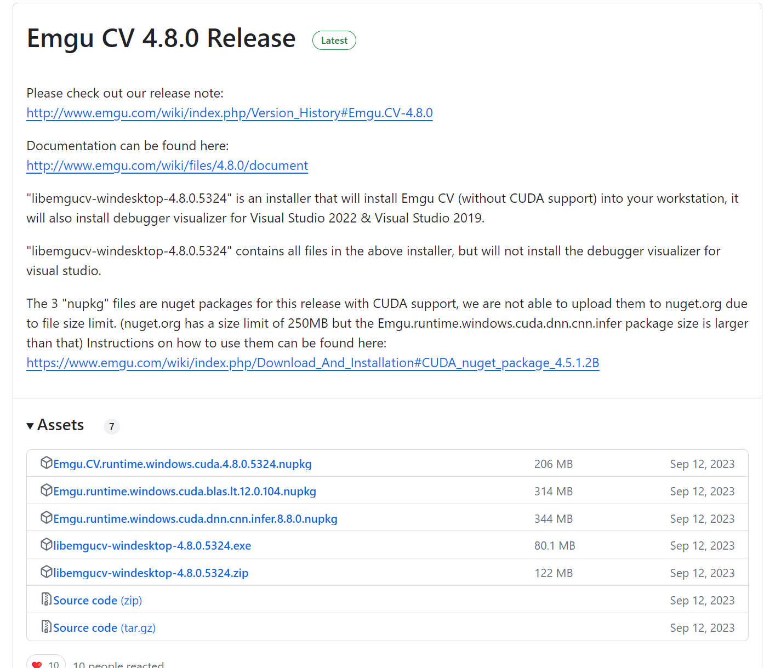
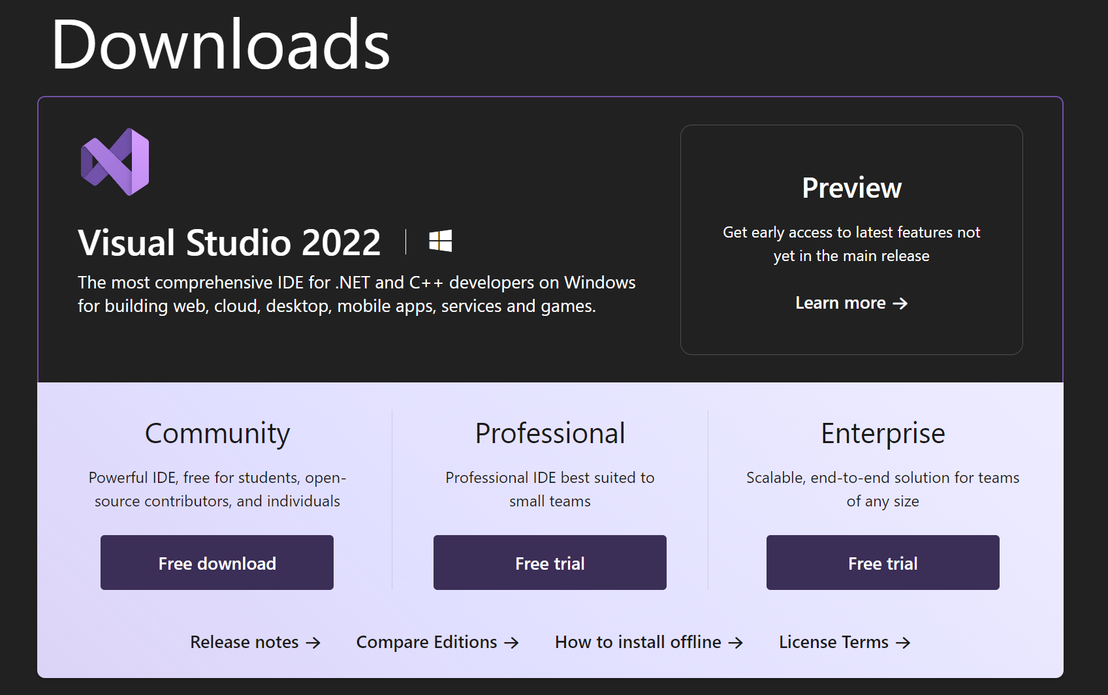
Start Program C# and Emgu ( Window Only)
Download Visual Studio (Languages C#)
[Link Window] https://visualstudio.microsoft.com/downloads/
Download Emgu Library (Not use NuGet Package)
[Link Window] https://github.com/emgucv/emgucv/releases

Slide 10
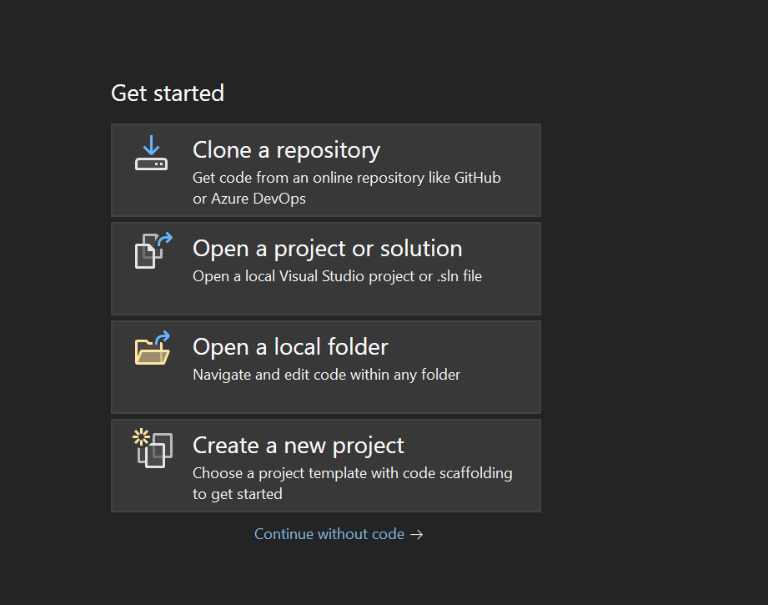
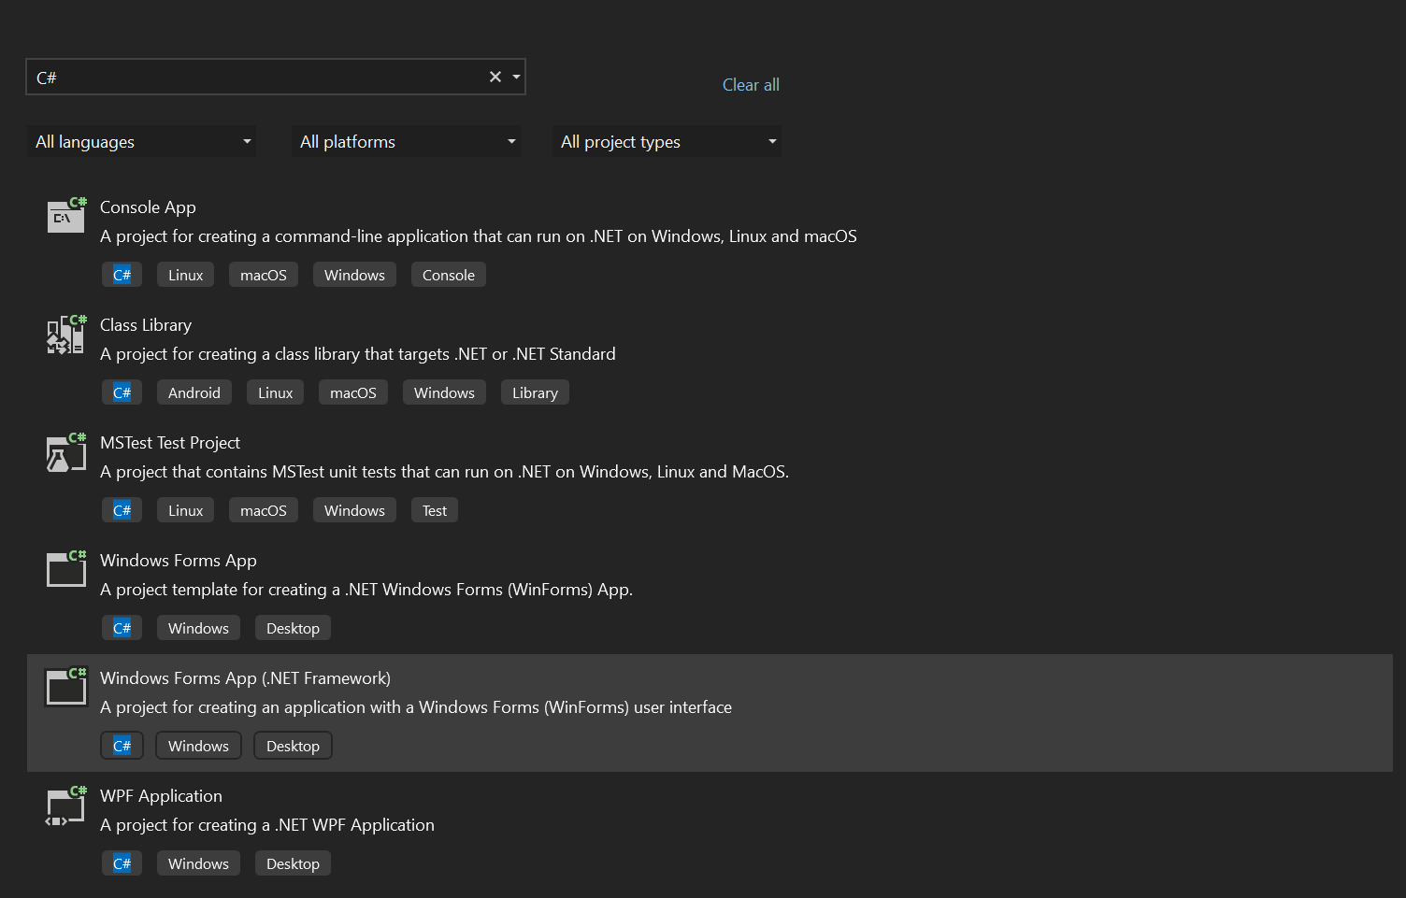
Start Project C#
Create Project Windows From App (.NET Framework)
1
2

Slide 11
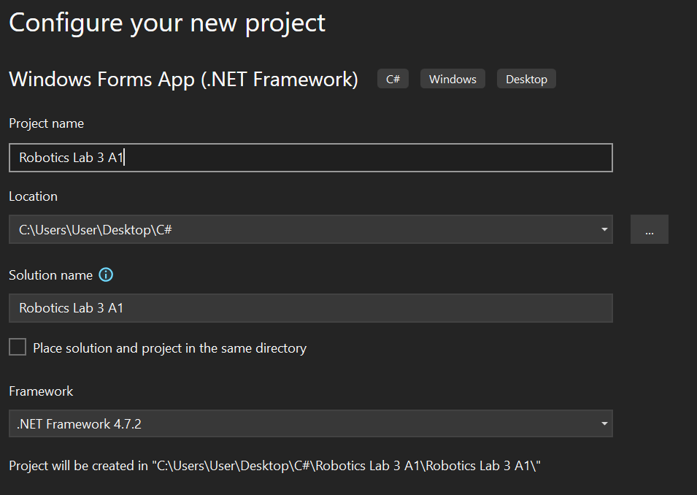

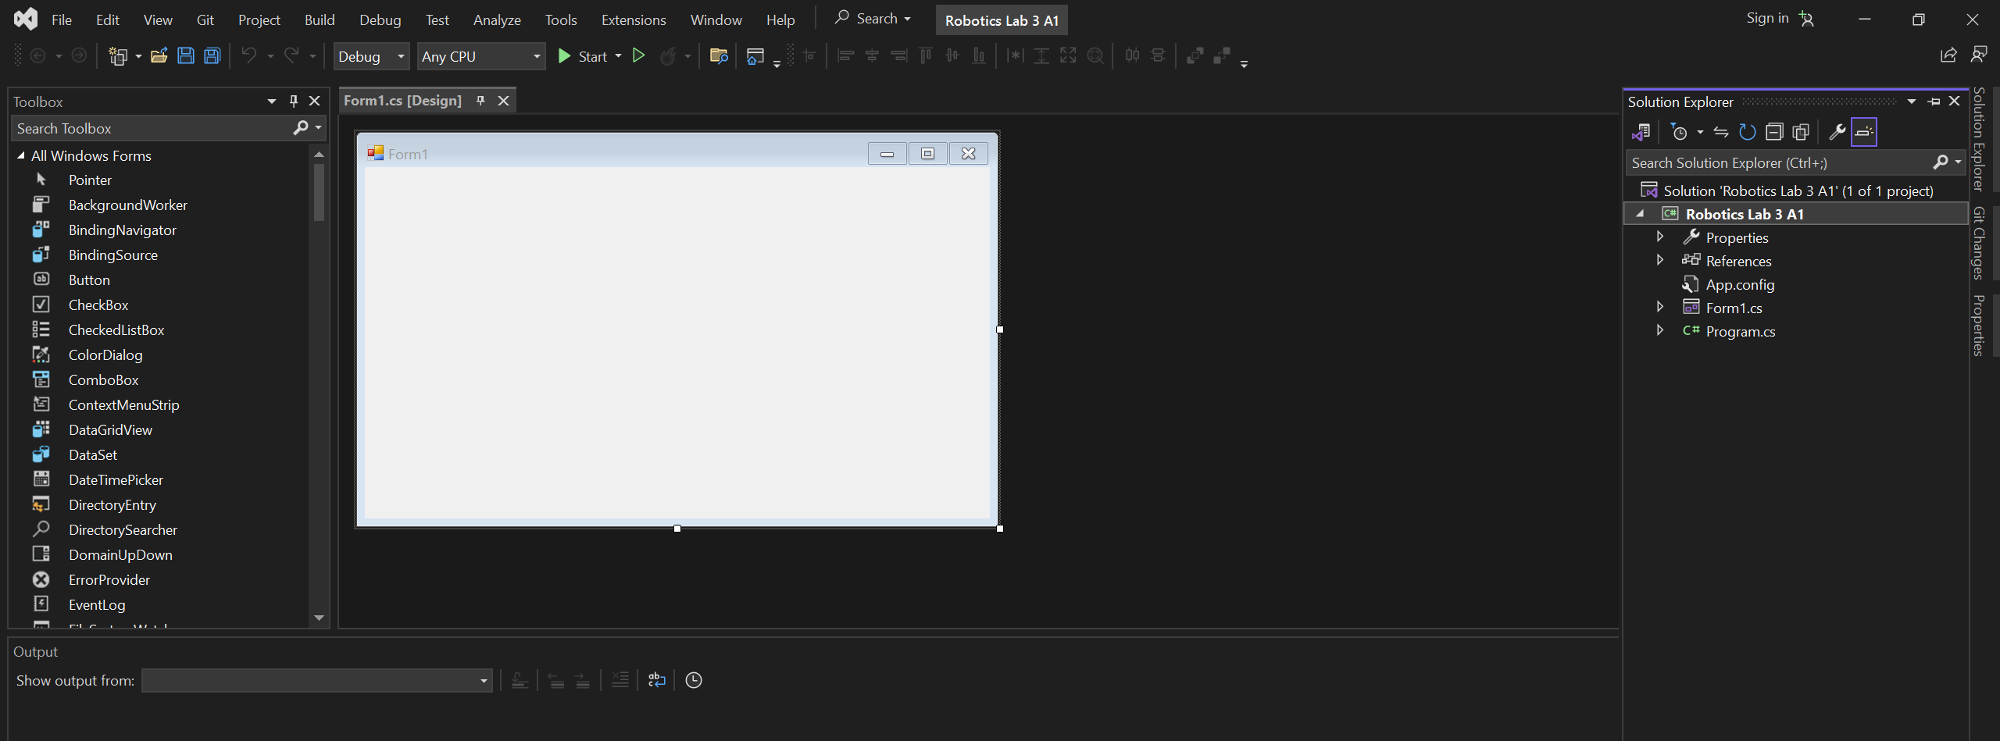
3
Name Project => Robotics Lab 3A1
Location PATH => location save project C#
Framework => 4.7.2 Version Developer
4
Complete Setup Project

Slide 12
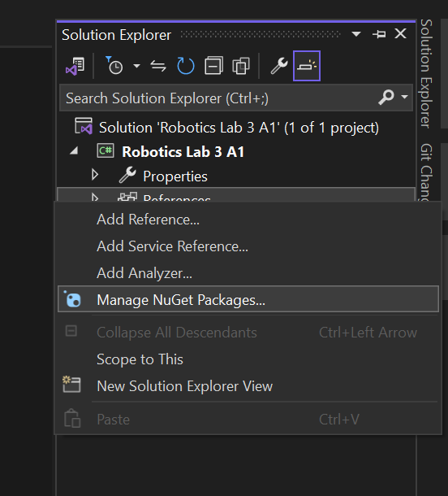
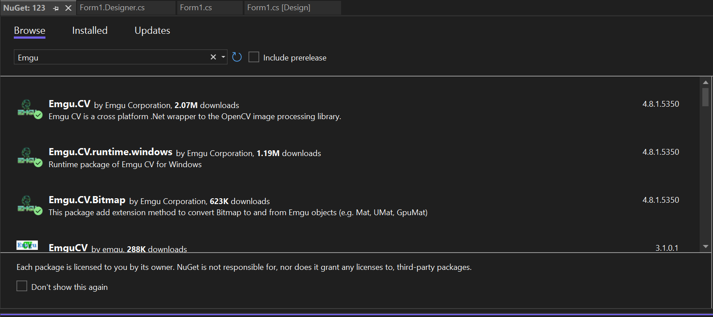
Start Add Emgu Library By C#
1
Open Solution Explorer in Project
2
Download Package NuGet
Emgu.CV
Emgu.CV.Bitmap
Emgu.CV.runtime.windows

Slide 13
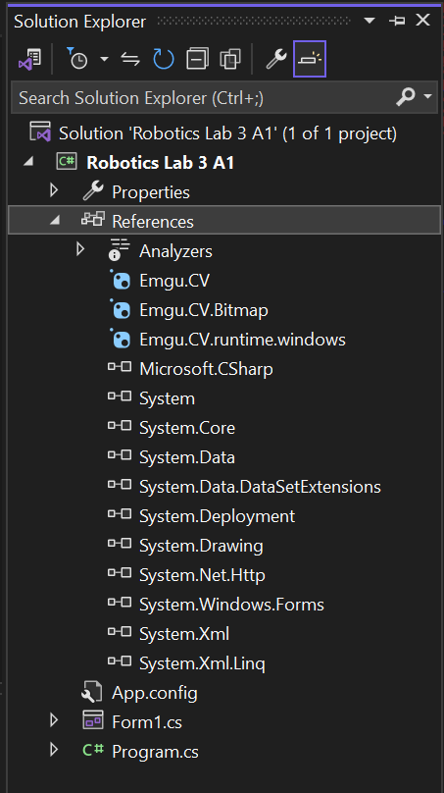
Check Solution Explorer in Project
3
After Install Package and Close NuGet
Complete Setup EmguCV

Slide 14
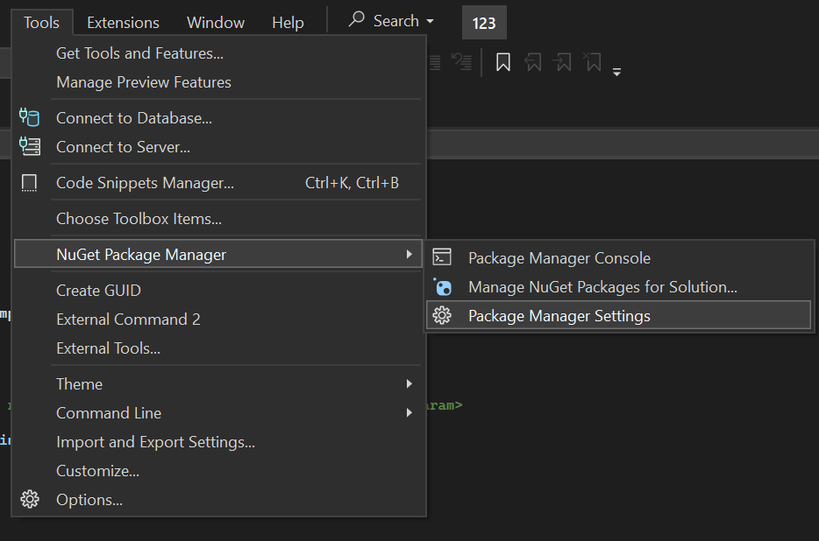
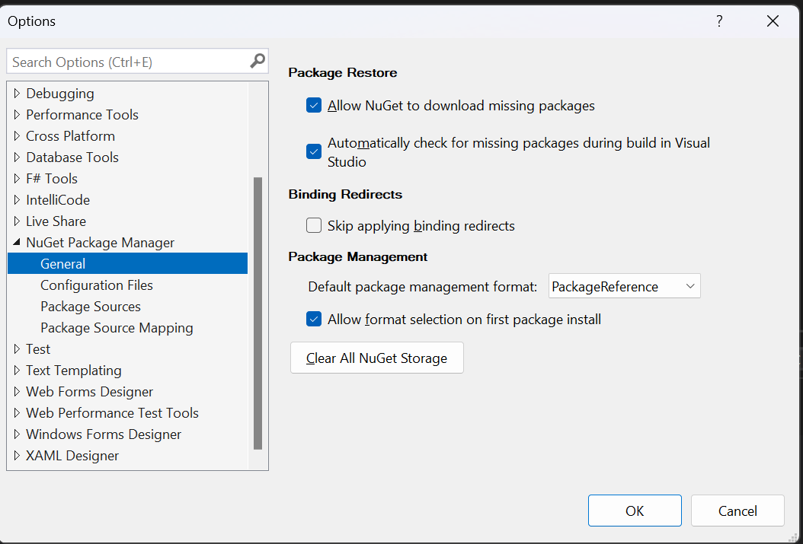
*** IF Error Download Package NuGet
Check Config Follow this select a [PackageReference] and confirm OK.
After OK try download again.
1
3
2

Slide 15
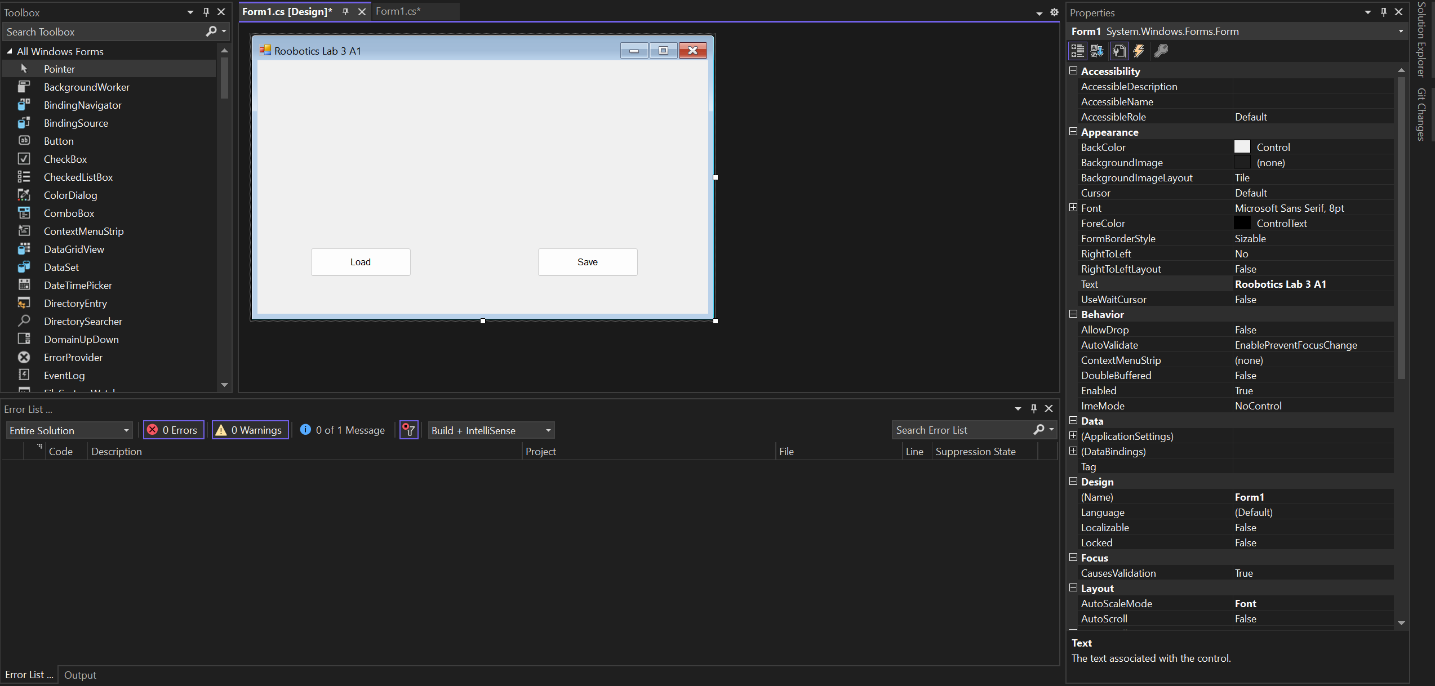
Design UI C# for Load Image and Save
Tools Design
Properties UI
UI Design Form1.cs

Slide 16
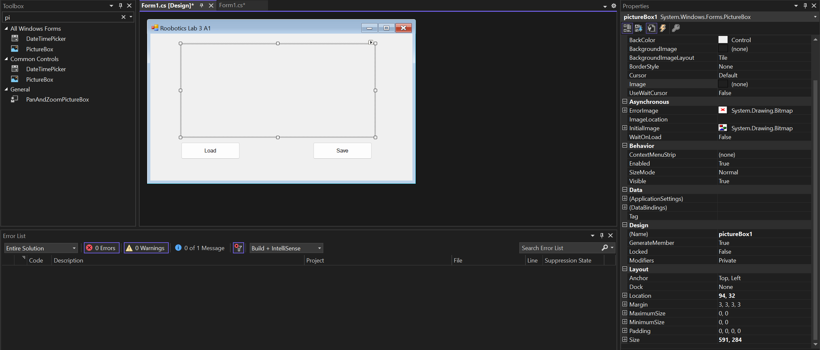
1
Find Object UI : PictureBox , OpenFileDialog , SaveFileDialog
2
3
Config Properties Object
Move Object drag and drop

Slide 17
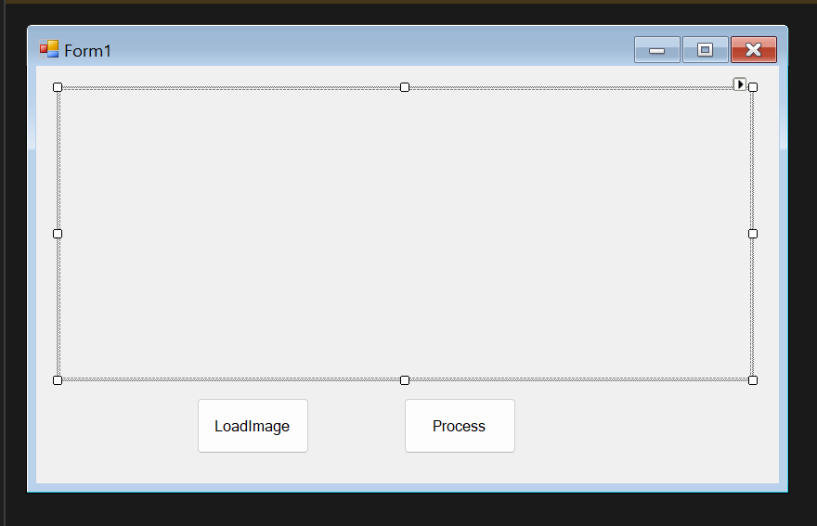
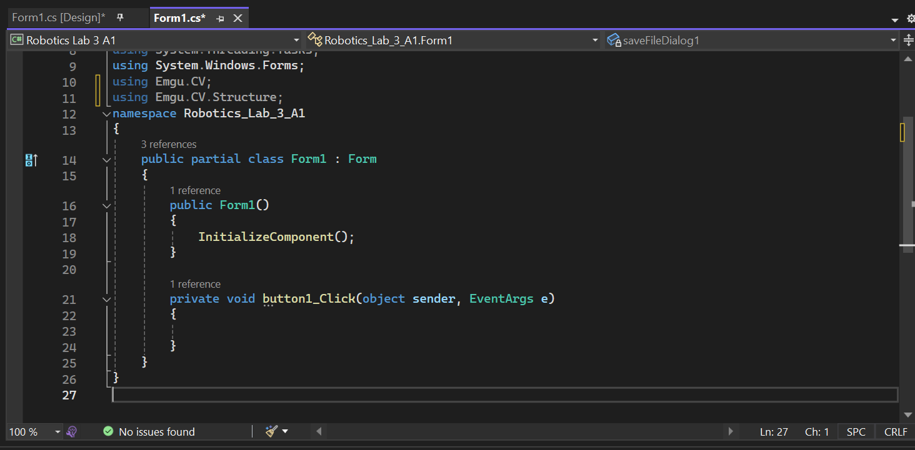
Add Library
[Double Click] Button Go to Code
Action for Button Properties
Object Toolbox UI
Code Function Object

Slide 18
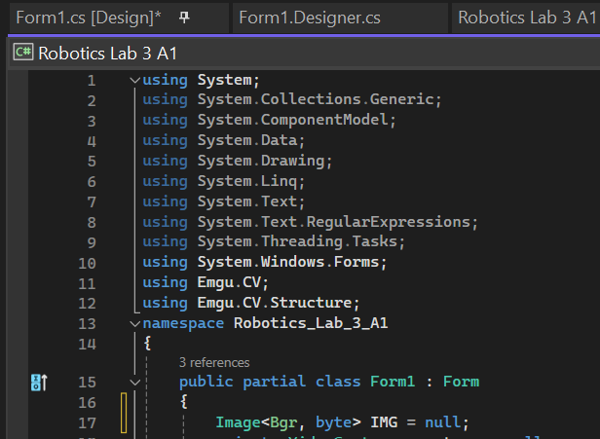
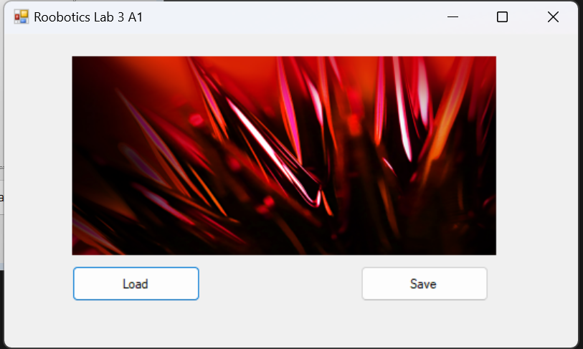
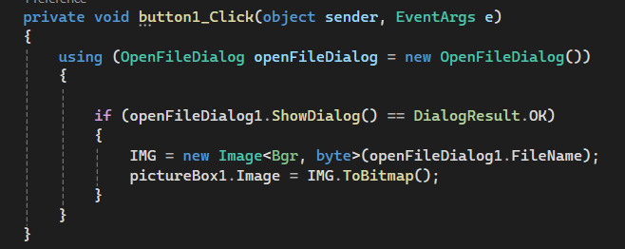
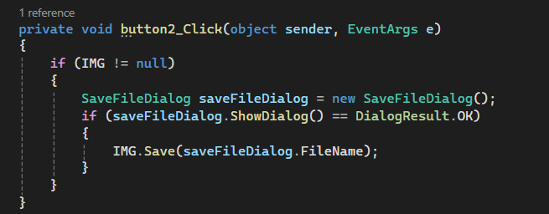
Example Code Load and Save
Add Variable for Frame
Image<Bgr, byte> IMG => Image frame BGR
Add EmguCV
Complete Project
Function Load
Function Save

Slide 19
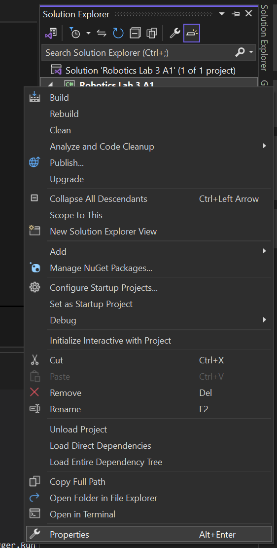
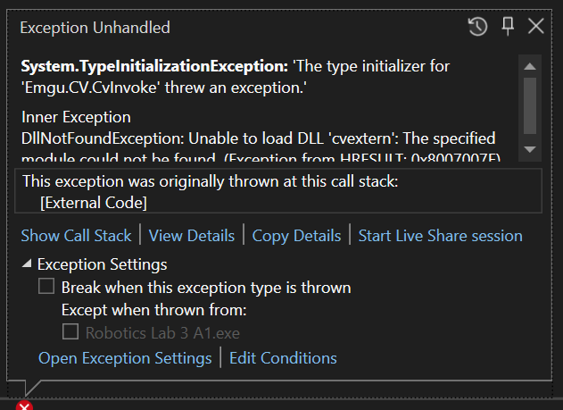
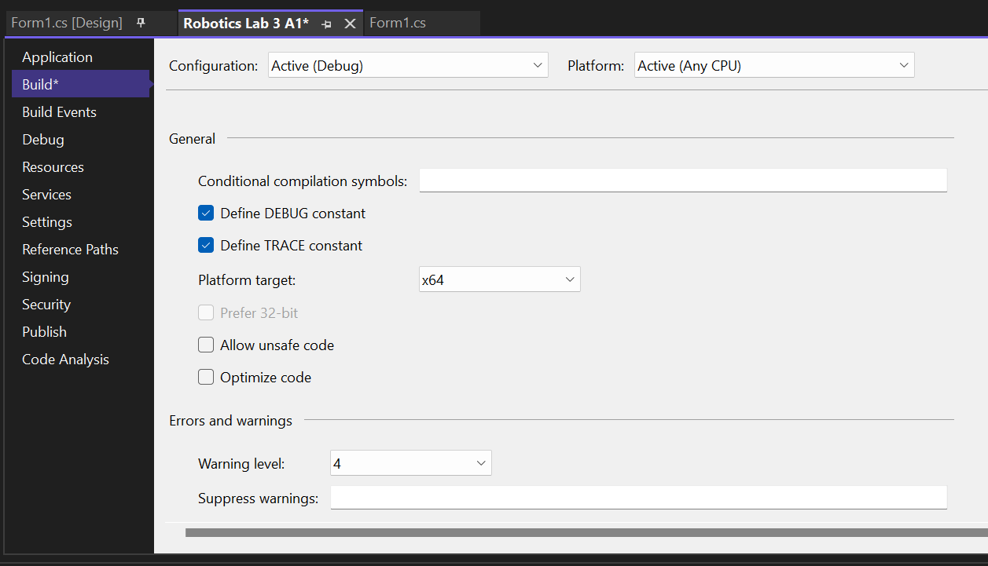
IF Error Code Load Image
Error Emgu use not support All platform build code dll
Click right Project “Robotics Lab 3 A1”
Select Properties -> Build -> Platform x64
Ctrl+S (save Config)
Run Program again

Slide 20
Project Load Image and Save Image
Assignment 1
Students must create project by Project Windows From App (.NET framework) C#
Name Project C#: Assignment 1
Detail UI
Button => Name “Load” => Function Load image
PictureBox1 => Size (300, 300)
Button => Name “Save” => Function Save image
Form1 => Name “Assignment1” ,Size (800,500)
When you have completed the task according to the procedure, please raise your hand and ask the Teaching Assistant (TA) to mark your score.

Slide 21
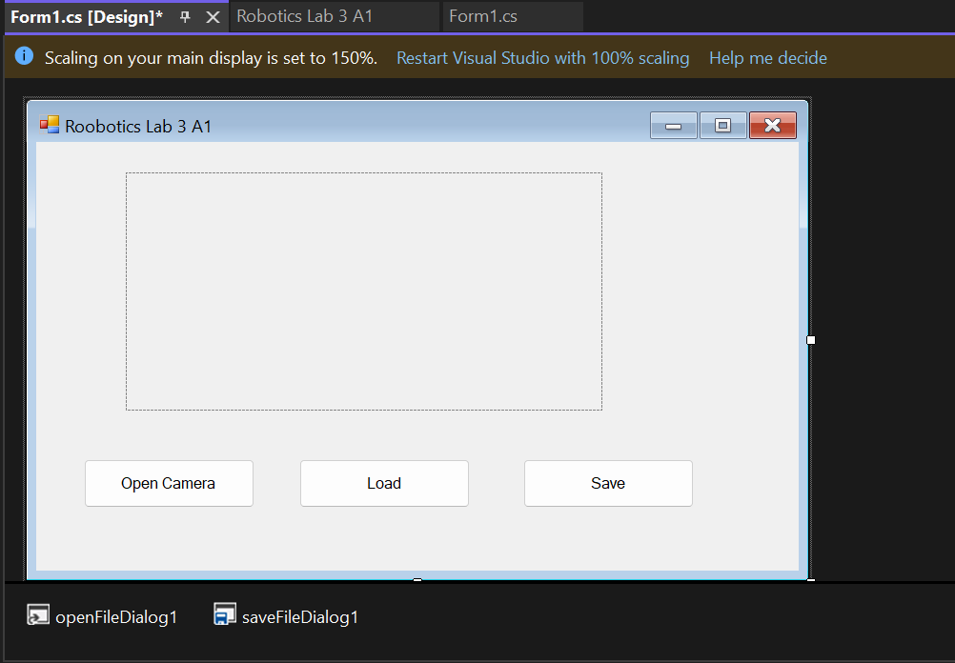
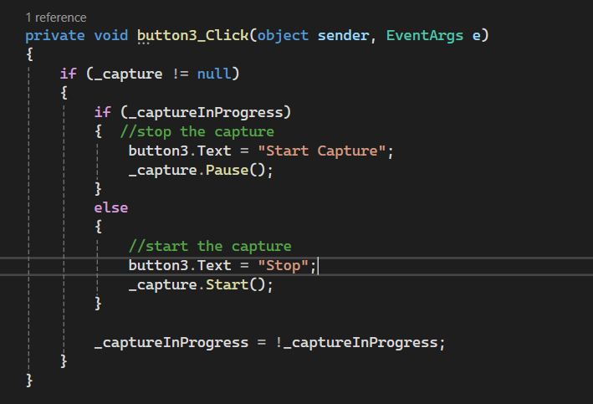
Design UI C# for Open Camera
Add Button
[Double Click] Button Go to Code

Slide 22
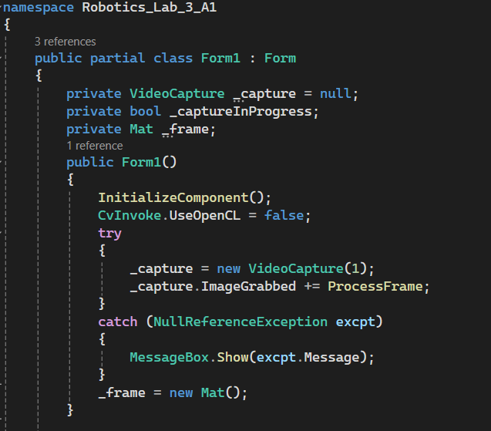
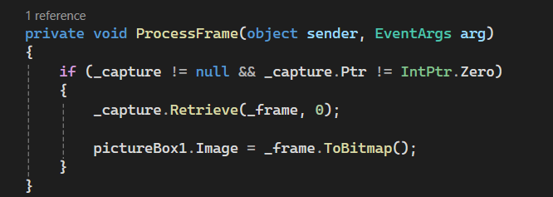
Example Add Code Open Camera
Add Variable for Camera
VideoCapture _capture => Object Video Hardware
Mat _frame => Object Image
Function Connect Camera
new VeideoCapture (0) by 0 => device0
Add Function Process Frame
_capture.Retrieve(_frame,0); => Function get image form video .
_frame.ToBitmap() => Change Image bit to image .

Slide 23
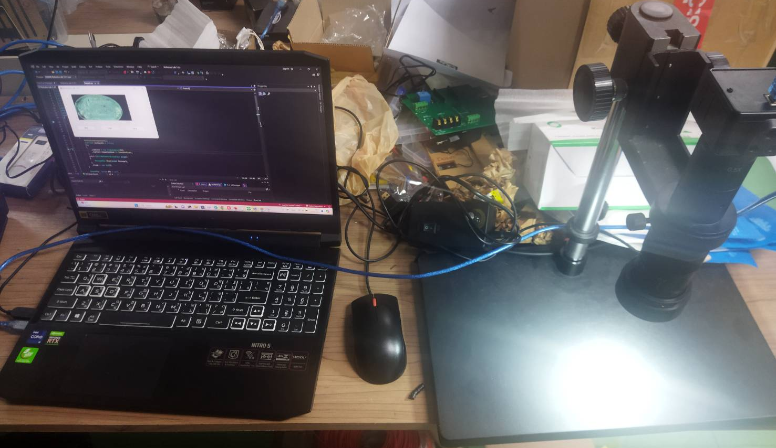
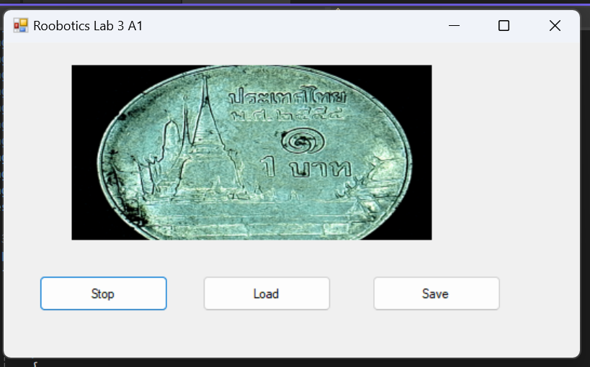
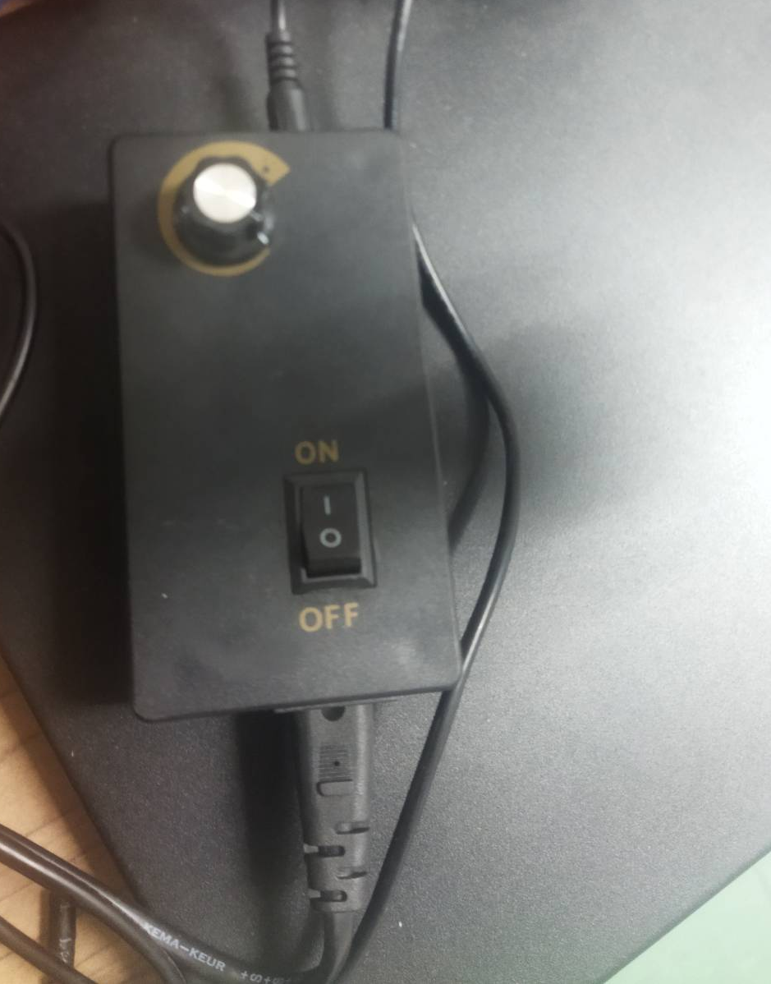
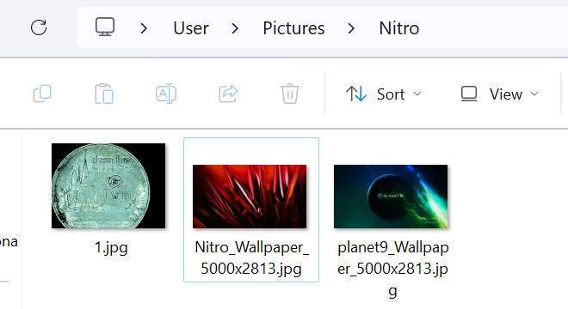
Run Hardware Camera
Control Light Source
Check Hardware and Control Light Source
Save Image File name = 1.jpg
Complete Project

Slide 24
Project Connection Hardware
Assignment 2
Students must create project by Project Windows From App (.NET framework) C#
Name Project C#: Assignment 2
Object : Coin 1 Bath
Detail UI
Button => Name “Open Camera” => Function Open Camera
PictureBox1 => Size (300, 300)
Button => Name “Save” => Function Save image
Form1 => Name “Assignment2” , Size (800,500)
Output
File Image Coin Capture 1 image => Filename “1.jpg”
When you have completed the task according to the procedure, please raise your hand and ask the Teaching Assistant (TA) to mark your score.

Slide 25
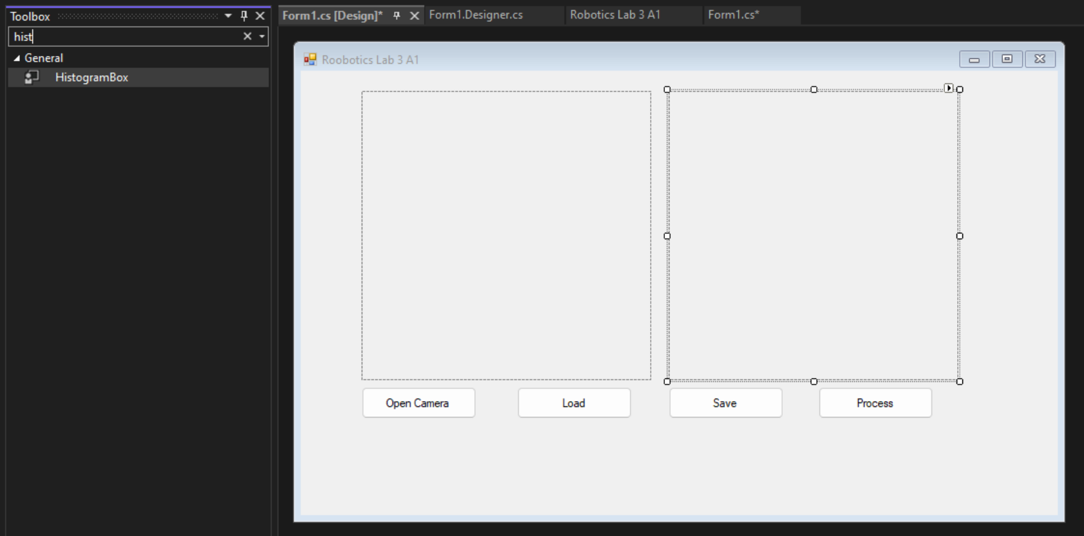
Design UI C# for Process Histogram
Add Button & Histogram Box
[Double Click] Button Go to Code

Slide 26
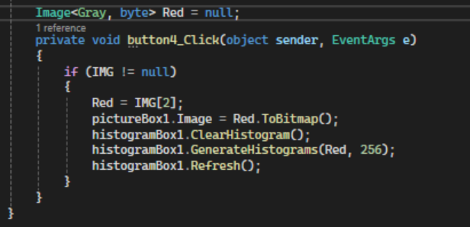
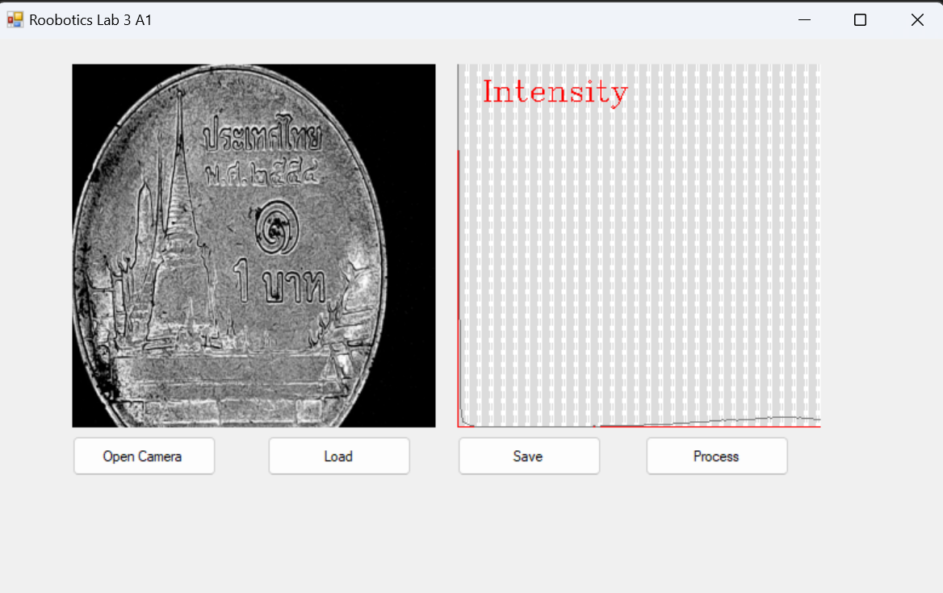
Example Add Code Open Camera
Add Variable for Frame Gray => Red = [2] form IMG [BGR]
Max Value = 256 in 1 Layer
Complete Project

Slide 27
Project Load Image and Save Image
Assignment 3
Students must create project by Project Windows From App (.NET framework) C#
Name Project C#: Assignment 3
Object Image : 1.jpg
Detail UI
Button => Name “Load” => Function Load image
PictureBox1 => Size (300, 300)
HistogramBox1 => Size (300, 300)
Button => Name “Process” => Function Generate Histograms image Layer Blue
Form1 => Name “Assignment1” ,Size (800,500)
Output
Show Image and Histogram Layer Blue
When you have completed the task according to the procedure, please raise your hand and ask the Teaching Assistant (TA) to mark your score.

